Slide 1

EECT 112 Lab Notebook
Digital Fundamentals
Spring 2015
Your Name
5-8-15

Slide 2

Table of Contents
1 - AND, OR 3
2 - NAND ALTERNATIVE 9
3 - Car Alarm (Midterm) 16
4 - NAND SR Latch 22
5 - Binary to 7-Segment Counter (hardware) 28
6a - Basic Stamp 1 - LED flasher 33
6b - Basic Stamp 2 - Temp Sensor/Heater 40
7 - Basic Stamp 3 - Binary Counter (software 47

Slide 3

Lab 1 - AND, OR

Slide 4
Lab 1-AND, OR
Objective
  Build circuits to confirm operation of AND and OR gates from Multisim.
Equipment and Material
    Elvis Chips Resistors
    Model: NIElvis II + 74LS08 (AND) (2) 10k ohm
    Part#: 198570A-02L 74LS32 (OR)
    Serial: 166C8F1
Research and Information
  Datasheet at www.ivytechengineering.com

Slide 5
Details and Procedures
Build circuit in Multism and see how the circuit works.
Go to the lab to wire up and to confirm the operation of AND, OR gates that was built in multism.
verified all combinations of inputs with expected outputs.
Take pictures of the circuit.

Slide 6
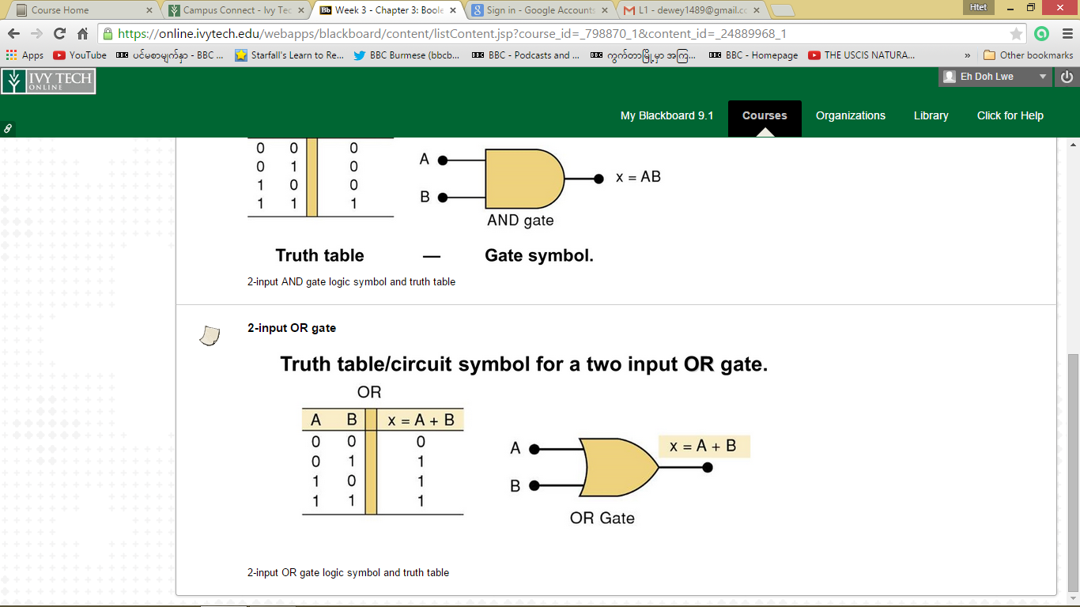
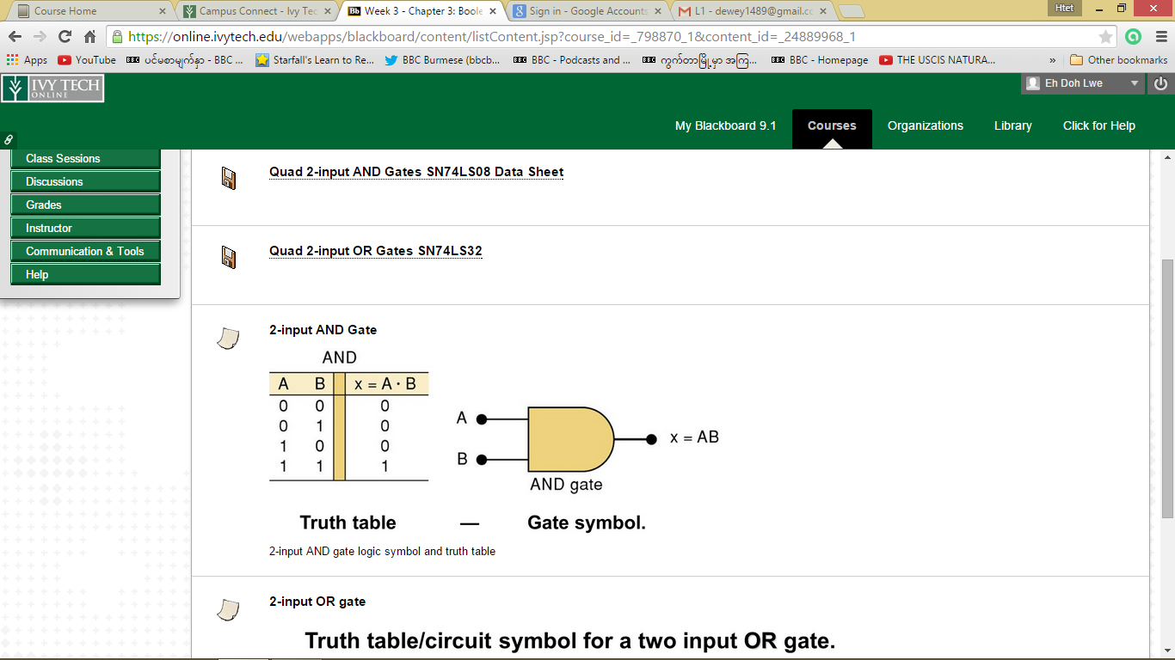
Truth Table

Slide 7
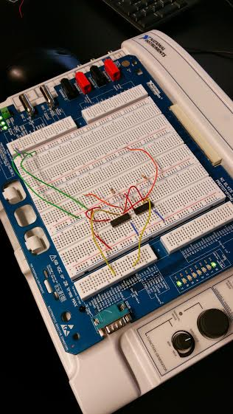
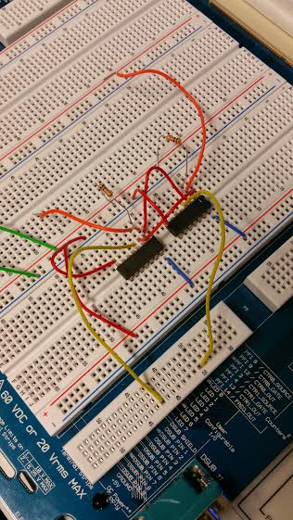
Lab 1 - AND, OR
74LS32 OR top chip
74LS08 AND bottom chip
Switch
Output for LED0
Output LED7

Slide 8
Conclusion
Took us a bit of time to wire up the circuit because we had to look up the datasheet for the chips so that we know what the pins are.
We followed the schematic in Multism to wire up and then we ran the circuit to see the operations but only one LED lit up. We recheck our wiring and then troubleshoot it to see what was wrong then found out the one of the LED was bad.
Overall, the circuit worked as expected.

Slide 9

Lab 2 - NAND ALTERNATIVE

Slide 10
Lab 2- NAND ALTERNATIVE
Objective
  Showing NAND equivalence.
Equipment and Material
    Elvis DMM Chips Resistors
    Model: NIElvis II + Brand: GW instek 74LS08 (AND) (3) 10k ohm
    Part#: 198570A-02L Model #: GDM8245 74LS32 (OR)
    Serial: 166C8F1 SN: CL860332 74LS04 (Inverter)
  74LS00 (NAND)
Research and Information
  Datasheet at www.ivytechengineering.com

Slide 11
Details and Procedures
Used a DMM to measure the logic 1 and 0 levels. Need 6 pictures minimum: 1) circuit; 2) LED on; 3) LED off; 4) DMM measuring a "1" with LED; 5) DMM measuring a "0" with LED; 6) DMM measuring a "1" without LED.

Slide 12
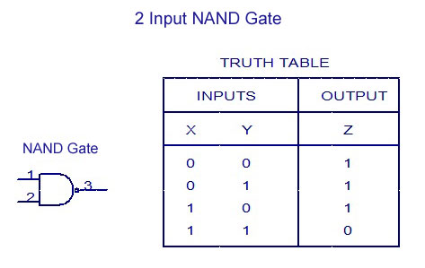
Truth Table

Slide 13
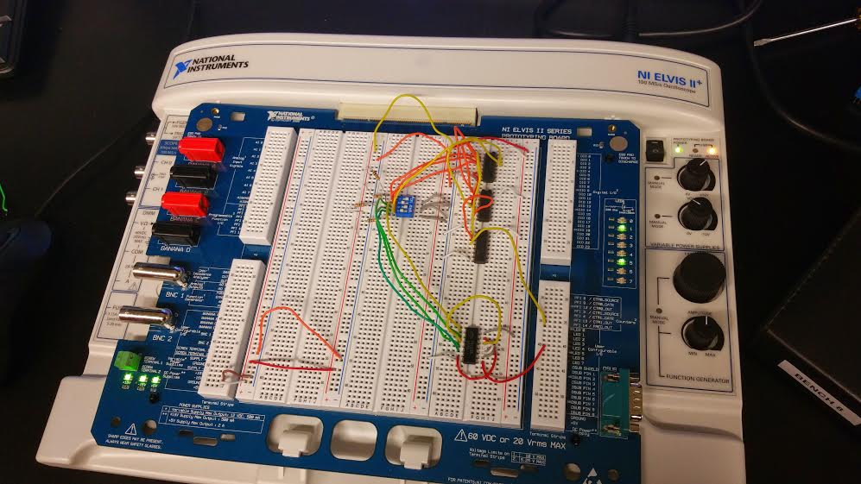
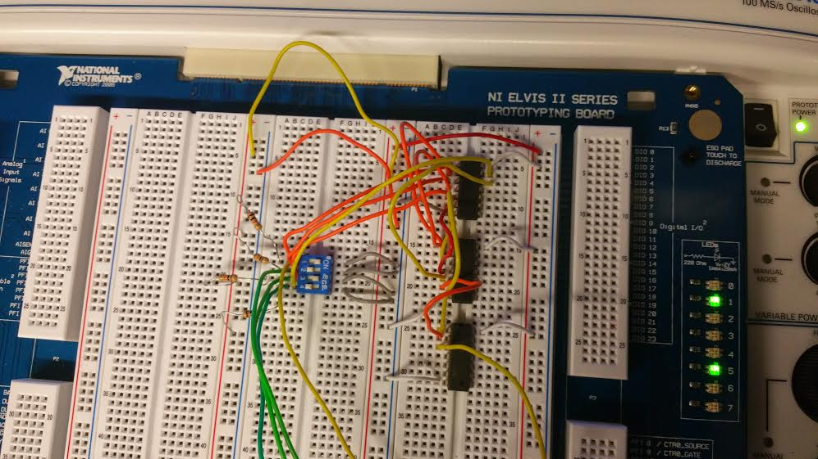
Pictures for first week
74LS04
74LS00
74LS32
74LS08

Slide 14
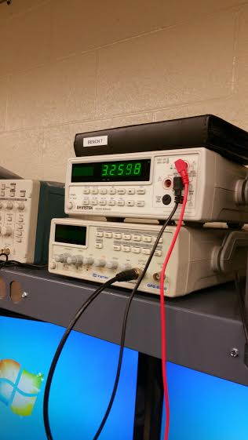
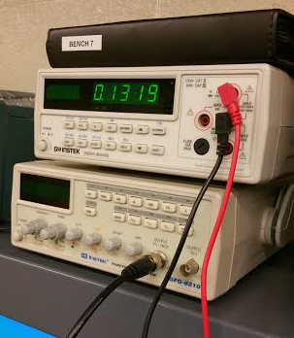
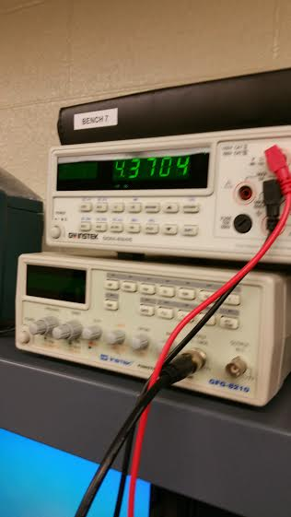
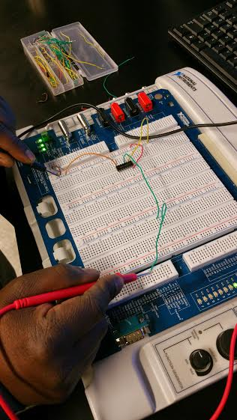
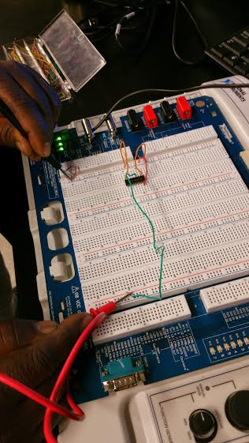
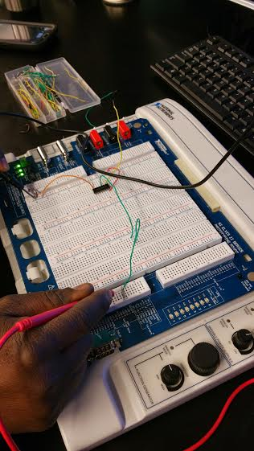
Picture for 2nd week

Slide 15
Summary and Conclusion
The first week of lab, we wired up 4 chips to show the NAND equivalence. The problem we had was that the LED didn’t turn on which later we found out that one of the chip was bad so we had to replaced it.
Second week we only wired up the NAND chip to measure the output with DMM.
What we’ve learned from this lab was that logic high with LED has lower voltage drop than without LED connected because some of the voltage is driving the LED.

Slide 16

Lab 3 – Car Alarm

Slide 17
Lab 3- Car Alarm
Objective
  designing logic for a Car Alarm given input and output requirements and going from start to finish.
Equipment and Material
    Elvis DMM Chips Resistors DIP Switch
    Model: NIElvis II + Brand: GW instek 74LS08 (AND) (3) 10k ohm
    Part#: 198570A-02L Model #: GDM8245 74LS32 (OR)
    Serial: 166C8F1 SN: CL860332 74LS04 (Inverter)
Research and Information
  Datasheet at www.ivytechengineering.com
  Used our knowledge on what we already learned

Slide 18
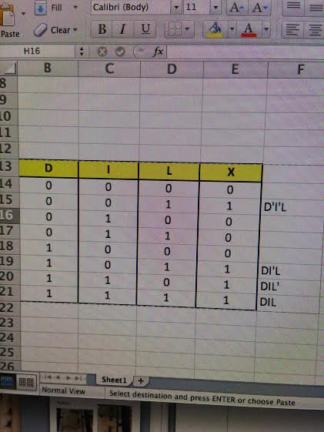
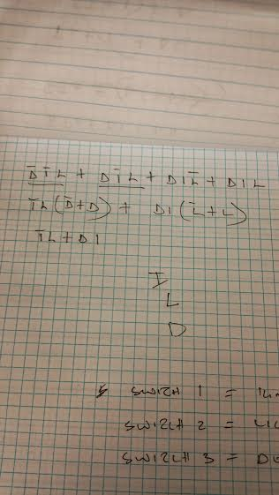
Truth Table and Simplification

Slide 19
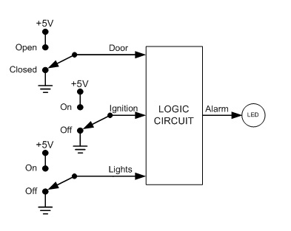
Car Alarm Diagram

Slide 20
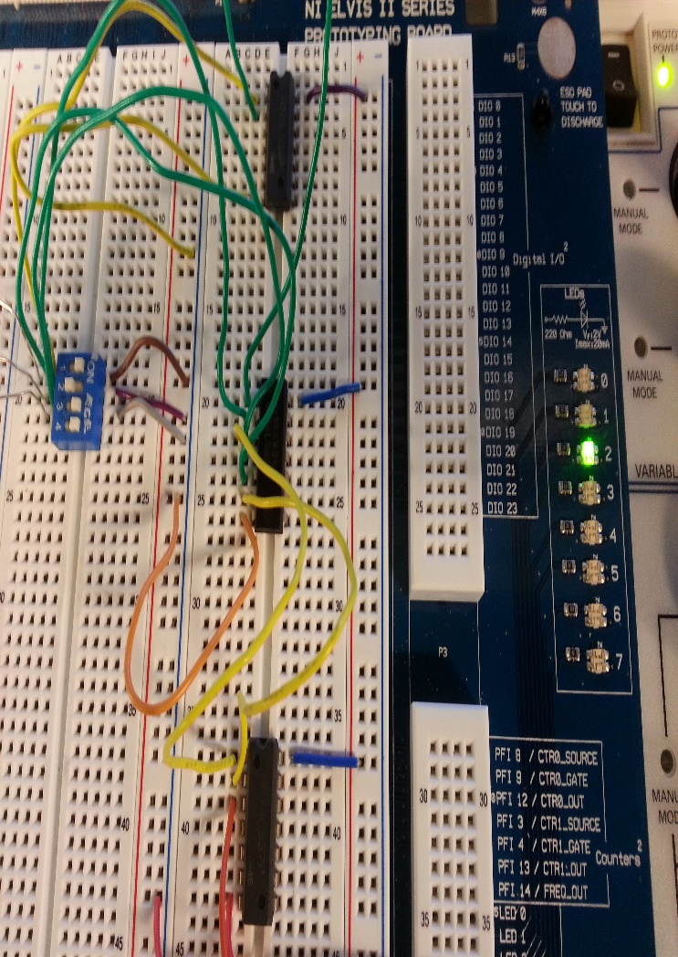
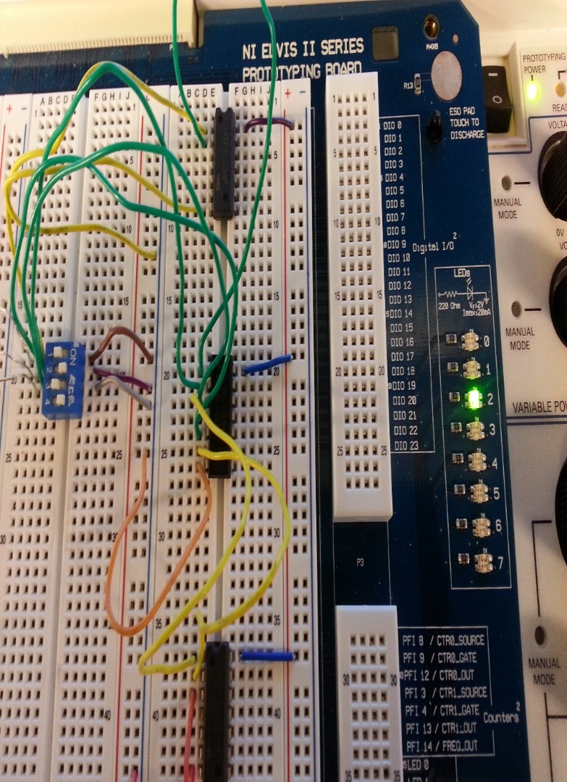
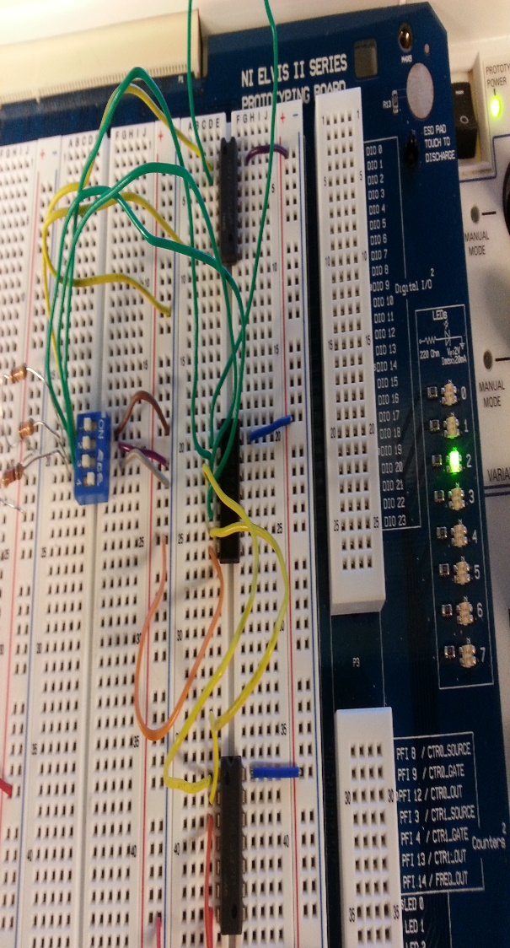
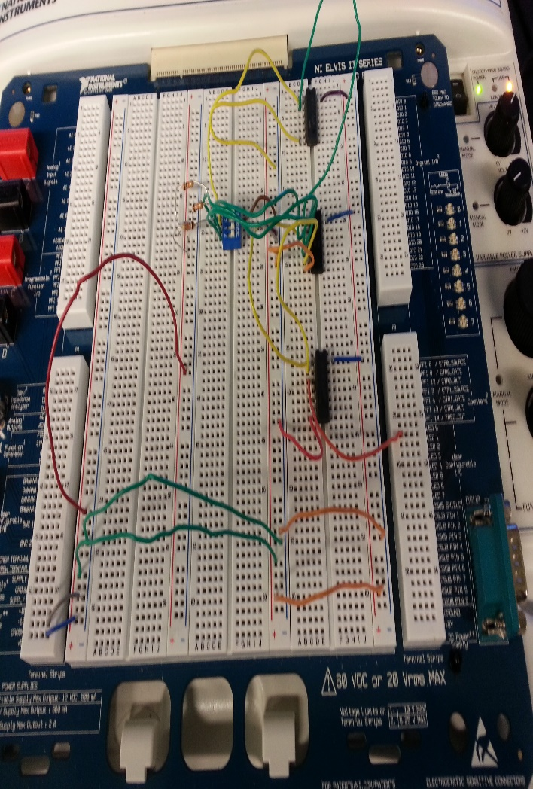
Pictures

Slide 21
Summary and Conclusion
Working out the problem and designing our circuit wasn’t difficult for us. The first solution we came up did work in Multisim but it involved 4 chips which we realized it would take longer to wire up in the lab so we looked at our equation and simplified it further, that brought us down to three chips.
After we built it in Multisim, we wired it up and did the demonstrations.
Our circuits worked and it met the given input and output requirements.

Slide 22

Lab 4 - NAND SR Latch

Slide 23
Lab 4- NAND SR Latch
Objective
  Learning how latches or flip flops works.
Equipment and Material
    Breadboard DMM Chips Resistors DIP Switch LEDS Brand: GW instek 74LS00 (NAND) (2) 10k ohm 2
    Model #: GDM8245
    SN: CL860332
Research and Information
  Chapter 5 lecture

Slide 24
Details and Procedures
Used breadboard, variable power supply, clip leads, DMM to measure supply voltage, built NAND SR latch using dip switches and pull up resistors. Used LED for output.

Slide 25
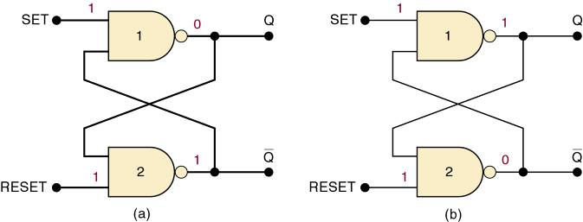
Information about a Latch
Summary of the NAND latch:
  SET = 1, RESET = 1—Normal resting state, outputs remain in state they were in prior to input.
  SET = 0, RESET = 1—Output will go to Q = 1 and remains there, even after SET returns HIGH.
    Called setting the latch.
  SET = 0, RESET = 0—Will produce Q = 0 LOW and remains there, even after RESET returns HIGH.
    Called clearing or resetting the latch.
  Inputs are SET and CLEAR (RESET).
Inputs are active-LOW—output will change when the input is pulsed LOW.

Slide 26
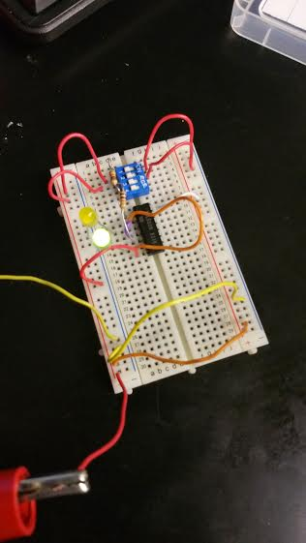
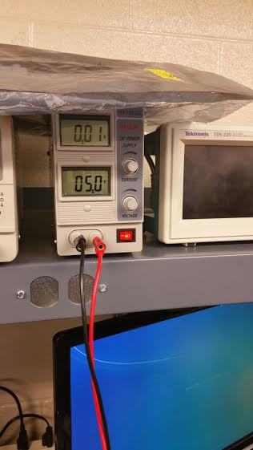
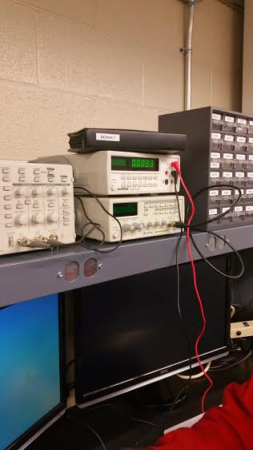
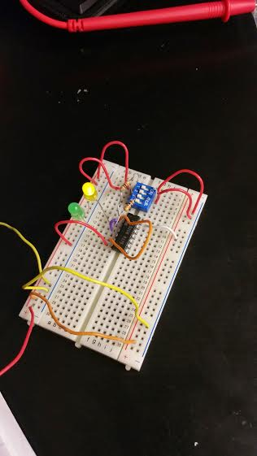
pictures

Slide 27
Conclusion
In the lab, we wired up the circuit without using the dip switch which gave us a hard time to set and to reset so we had to put one in.
I think we need to spend more time on latches because I still don’t know the purpose of it.

Slide 28

Lab 5-Binary to 7-Segment Counter (hardware)

Slide 29
Lab 5-Binary to 7-Segment Counter (hardware)
Objective
  built a 4-bit binary counter to count from 0000 to 111
Equipment and Material
    Breadboard Chips Resistors Display 74LS193 (1) 10k ohm MAN72
    74LS47
Research and Information
  Display datasheet at www.ivytechengineering.com and YouTube

Slide 30
Details and Procedures
Using Multisim, build a 4-bit binary counter to count from 0000 to 1111 using D-Flip Flops, 74LS47D, as Toggle flip flops. Used a new input, digital clock set to 1Hz for clock signal. Used a Logic Analyzer to show traces. Switched to a DCD_HEX_GREEN 7-Segment Display that accepts the 4-bit counter states and displays the HEX value, thus counting from 0 to F for the 0-15 binary states.

Slide 31
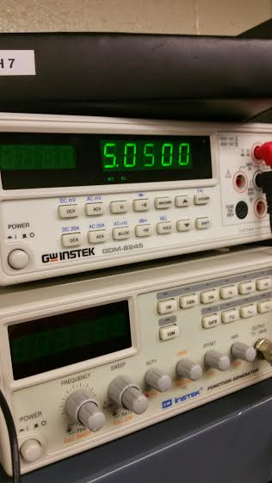
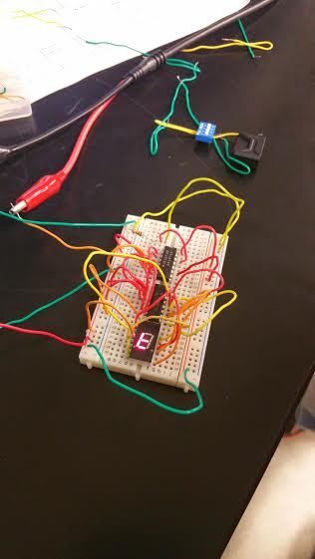
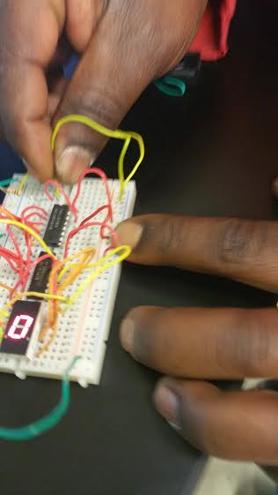
Lab 5-Binary to 7-Segment Counter (hardware)

Slide 32
Summary and Conclusion
This was a fun lab for me but took a long time to hook it up because not only we had to looked up the datasheets for the chips but also the 7 segments display.
After the circuit had been wired up, it didn’t work. We found out that we had fried up the 74LS193 chip and the 7 segments display.
I’d like to mess more with this lab and maybe add more stuff to it.

Slide 33

Lab 6a – Basic Stamp 1 - LED flasher

Slide 34
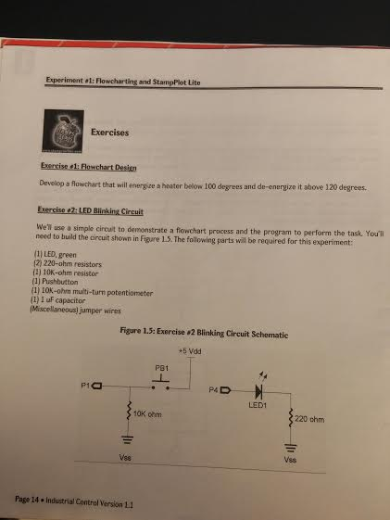
Lab 6-Basic Stamp 1 - LED flasher
Objective
  learning to find out about Basic Stamp and the programming
Equipment and Material
  Basic Stamp 2, serial cable, power supply
Research and Information
  Overviews at the www.ivytechengineering.com/basic_stamps site provided.

Slide 35
Details and Procedures
Complete Exercise #2, LED Blinking Circuit, from Industrial Control Student Workbook Version 1.1. The circuit has a single input button and a single output LED. Write a program for when the pushbutton is pressed, blink the LED five times over 10 seconds then stop and wait for another press of the pushbutton.

Slide 36
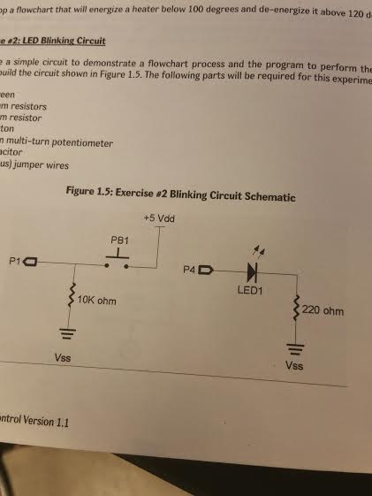
Schematic

Slide 37
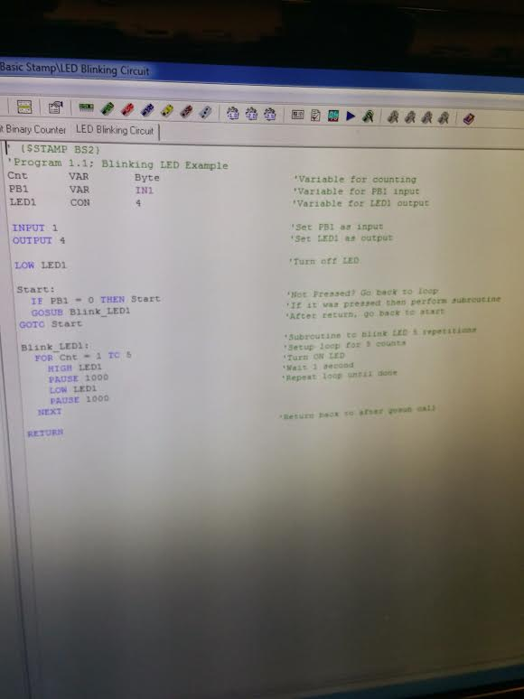
Code

Slide 38

Video
LED supposed to flash 5 times in 10 seconds but the video showed only 4 times because it got cut off.

Slide 39
Conclusion
Though there was a schematic to follow to wire up, I still needed help and my partner helped me on it.
This lab went really fast and we were happy with the result.

Slide 40

Lab 6b - Basic Stamp 2 - Temp Sensor/Heater

Slide 41
Lab 6b-Basic Stamp 2 - Temp Sensor/Heater
Objective
  learning to find out about Basic Stamp and the programming
Equipment and Material
  Basic Stamp 2, serial cable, power supply, 1uf Capacitor, 10k potentiometer
Research and Information
  Overviews at the www.ivytechengineering.com/basic_stamps site provided.

Slide 42
Details and Procedures
Complete Exercise #3, Analog Data Input, from Industrial Control Student Workbook Version 1.1. Write a program to simulate process control of a Heater Control using an RC network with a capacitor and potentiometer. Temperature is monitored and a heater is energized below 100 degrees and de-energized above 120 degrees. The potentiometer will represent a temperature sensor and the LED will represent the heater being energized. Will use the Debug window to display our temperature and status of the heater.

Slide 43
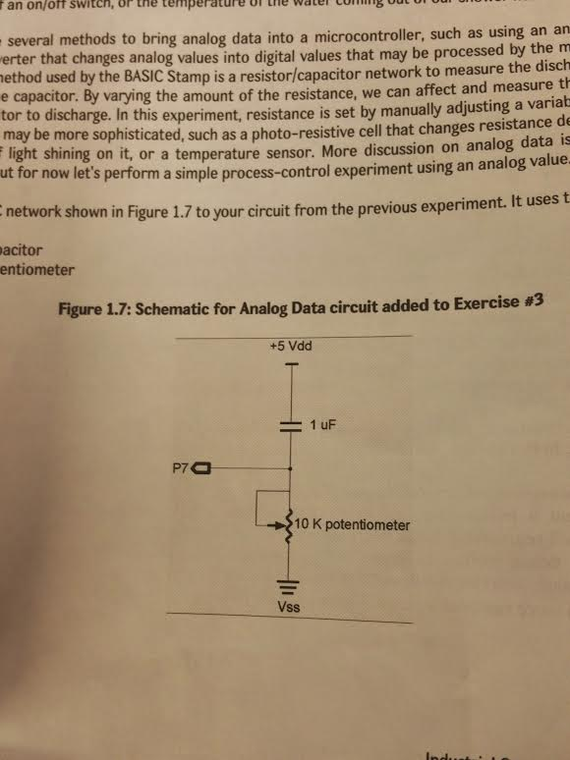
Schematic

Slide 44
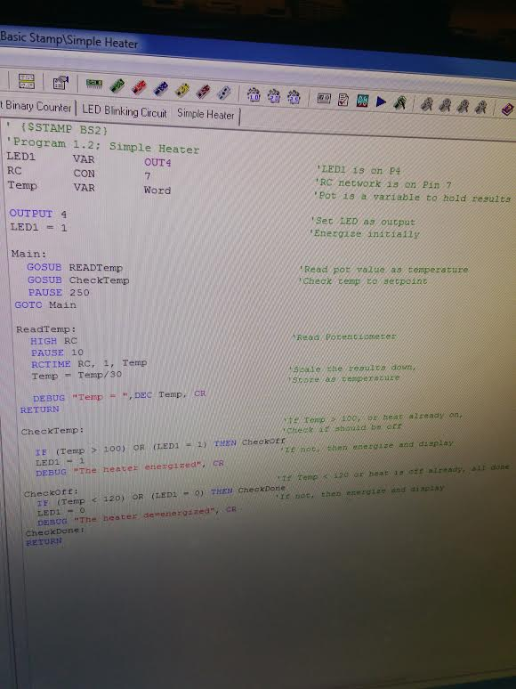
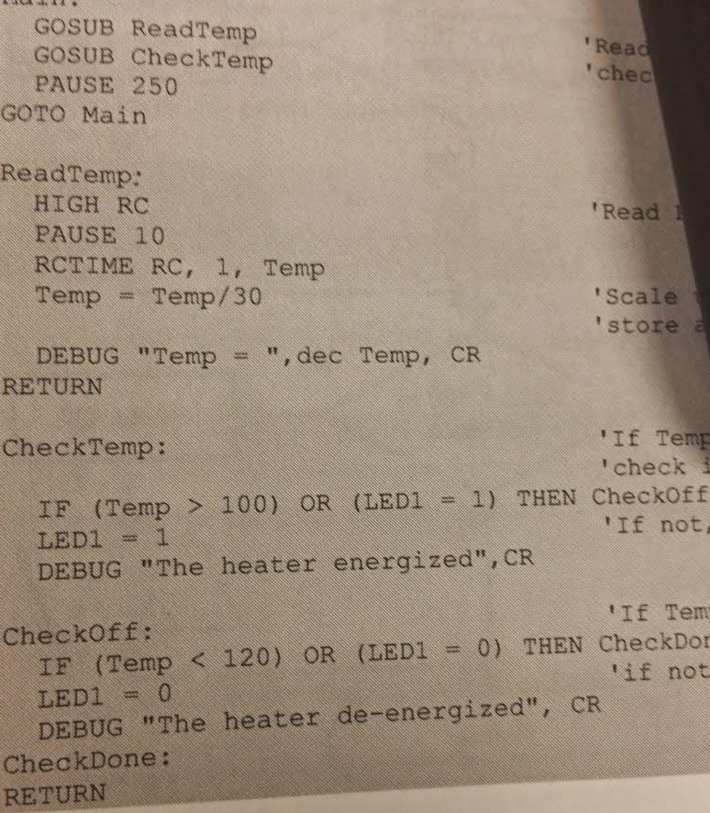
Code

Slide 45
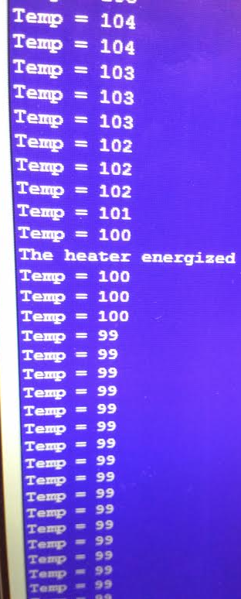
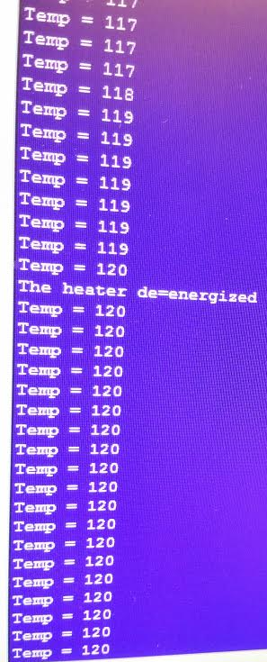
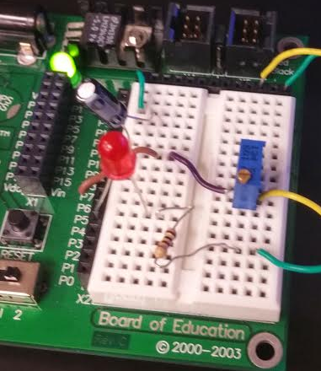
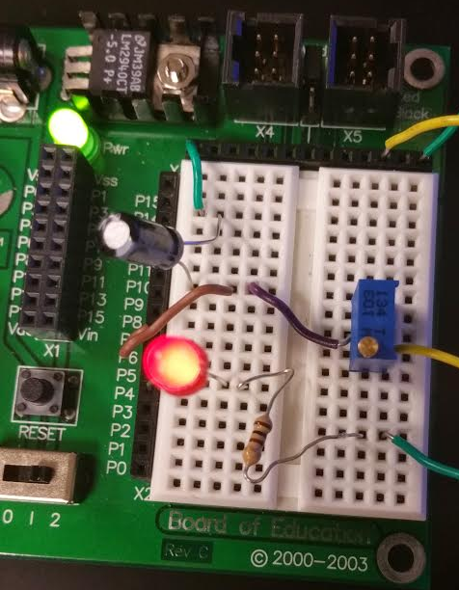
Pictures
Pot represent temperature sensor
LED represent heater being enerized

Slide 46
Conclusion
The first problem we had with this lab was that I didn’t put in the pot right because I didn’t know that we can’t have the pin put in in the same row across. After we had it figure out, it still didn’t work because there was no power going to the capacitor which should be across from the wire that is providing power. It was my fault for thinking that the power was going up and down just like in Elvis.
What we had learned was that the greater resistance, the longer for capacitor to discharge.

Slide 47

Lab 7 - Basic Stamp 3 - Binary Counter (software)

Slide 48
Lab 7-Basic Stamp 3 - Binary Counter (software)
Objective
  Use BASIC Stamp to build and program a circuit that counts a 4-bit binary count from 0000 to 1111 in binary using 4 LEDs.
Equipment and Material
  Basic Stamp 2, serial cable, power supply, 4 LEDs, 3 resistors.
Research and Information
  Overviews at the www.ivytechengineering.com/basic_stamps site provided.

Slide 49
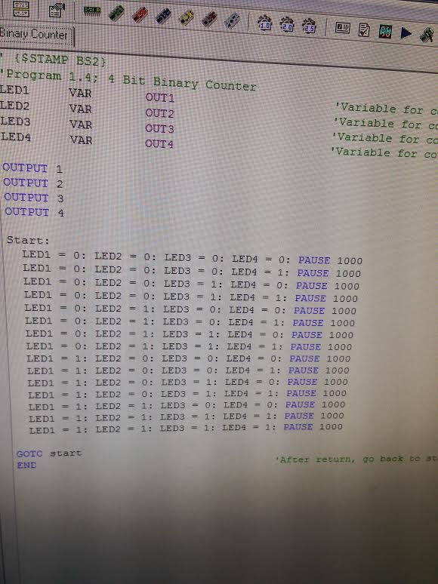
Code

Slide 50
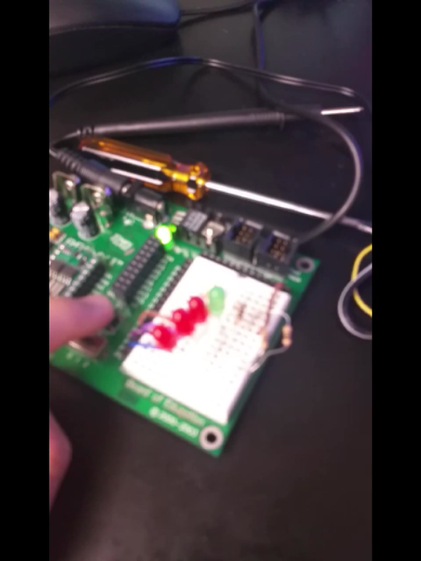
Video

Slide 51
Conclusion
Figuring out the code for this exercise was a little tricky. It took some times to think 0f how to program it to make it work.
This one the step to our final project.
It all came to make sense when we had it working.

